Slide 1
PBU Walls(TMP Base)

Slide 2
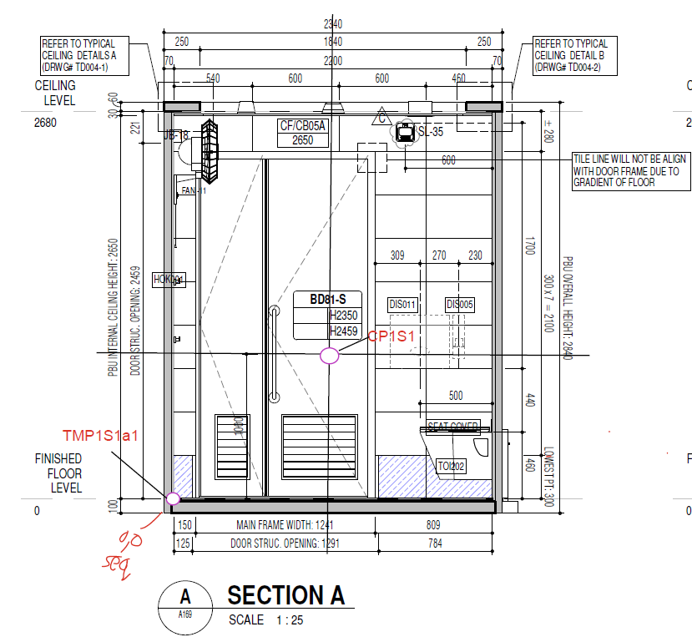
Wall 1

Slide 3
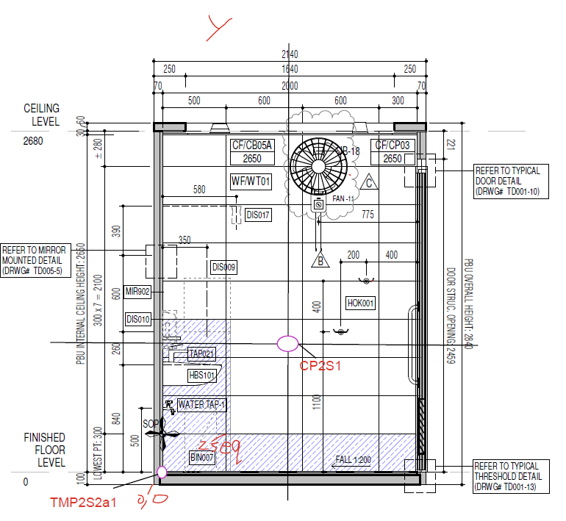
Wall 2

Slide 4
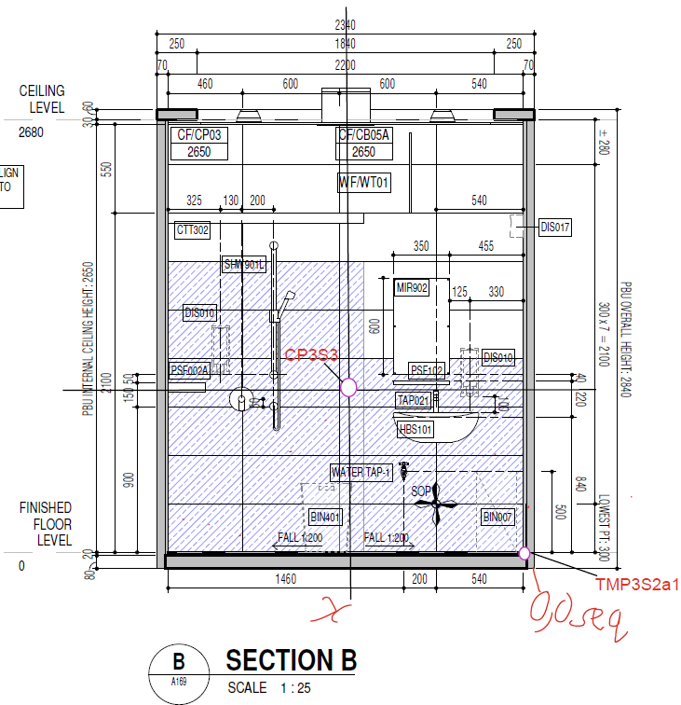
Wall 3

Slide 5
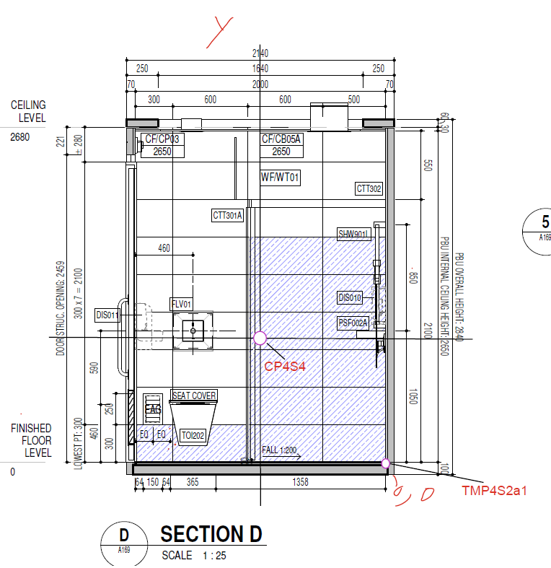
Wall 4

Slide 6
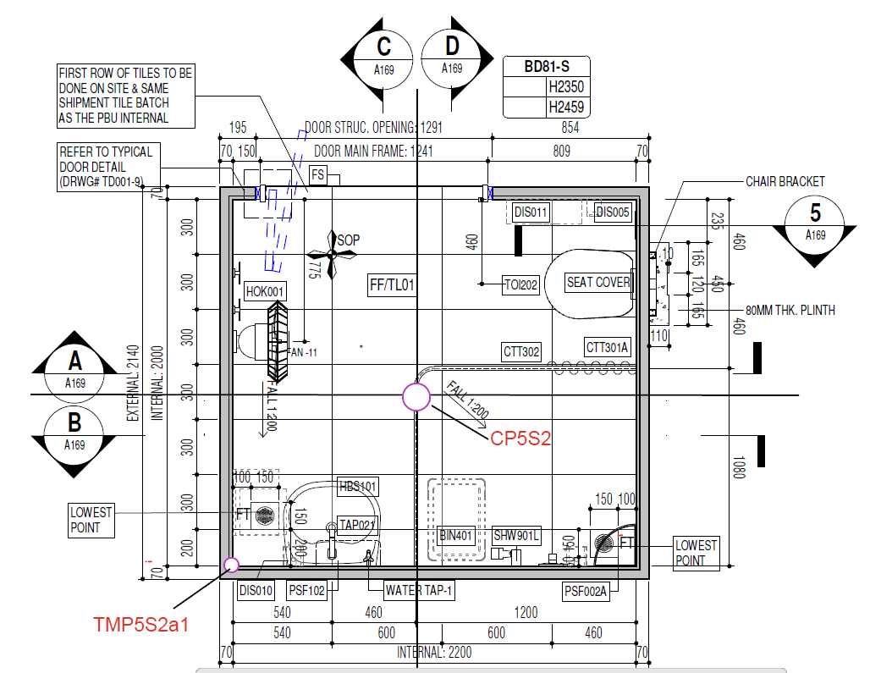
Wall 5(Floor)

